Slide 1

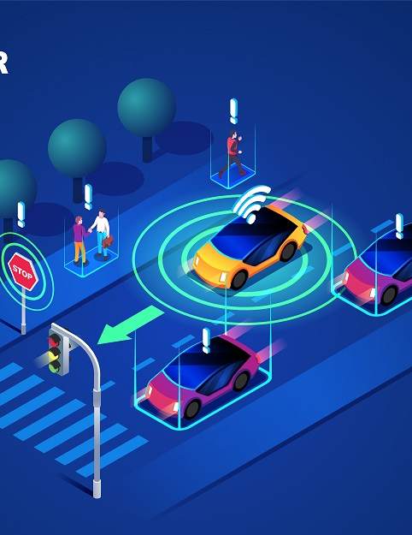
Car accident detection system
Michael Leib
Yuval Yacov Said

Slide 2

Motivation
In 2022, according to the Road Safety Authority, 351 people were killed in fatal road accidents in Israel.
Worldwide, there are millions of road accident fatalities, many of which can be prevented by providing fast and focused emergency services.

Slide 3
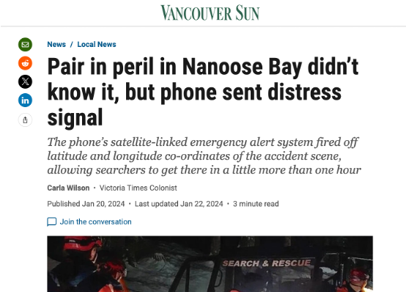
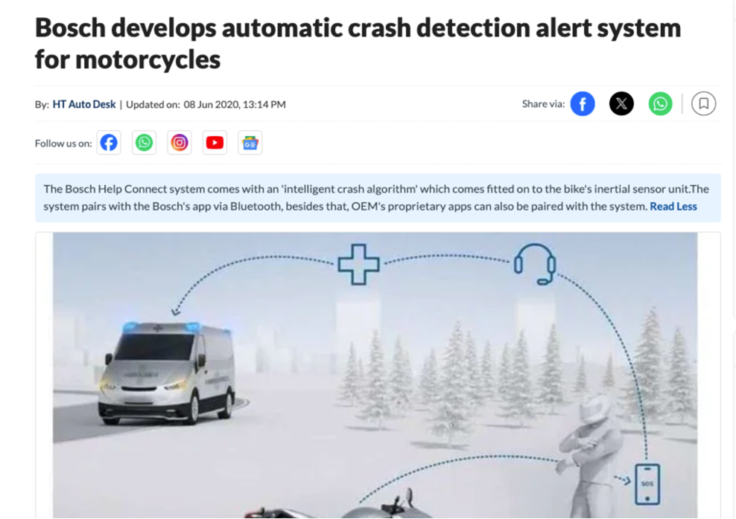
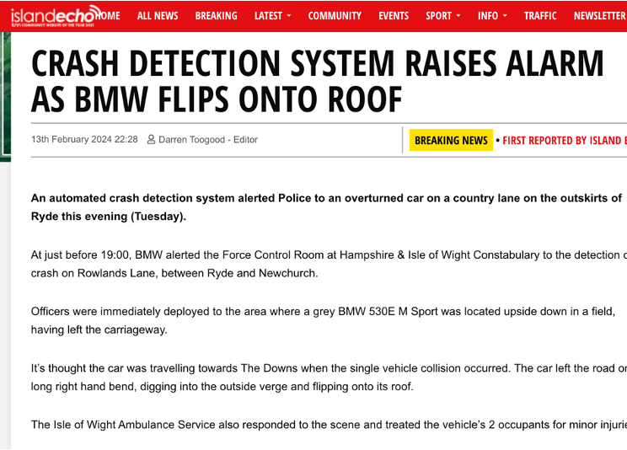
Motivation

Slide 4




Introduction
Processing
Identification
Data collection
Emergency alert

Slide 5


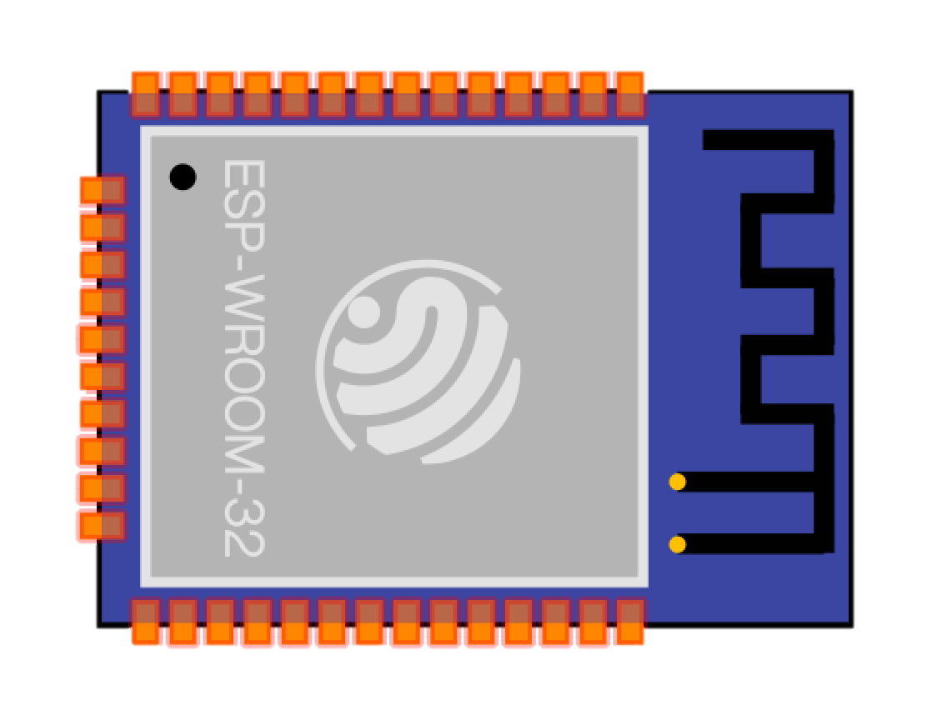


Main Components
GPS sensor
Acceleration sensor
Temperature sensor
ESP32
MQTT
AWS services

Slide 6
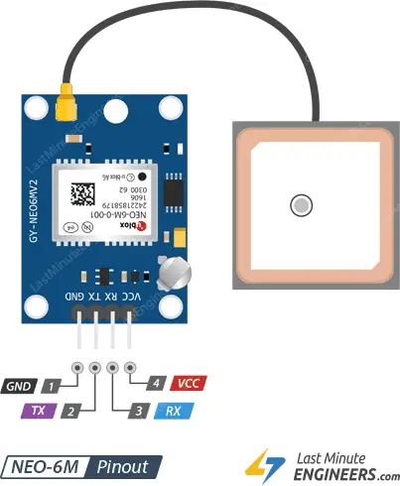
gy gps6mv2 sensor (GPS)
The GY-GPS6MV2 is a compact GPS module that combines a GPS receiver and an integrated antenna, based on the Ublox NEO-6M chipset. It allows devices to receive accurate positioning and timing data from satellites. This module is commonly used in applications such as vehicle tracking, navigation systems, and location-based services. It communicates with other devices using standard serial communication protocols like UART.

Slide 7
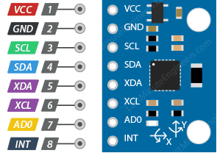
MPU6050 sensor (accelerometer & temperature)
MPU6050 is a three-axis accelerometer and three-axis gyroscope Micro Electro-mechanical system (MEMS). It aids in the measurement of velocity, orientation, acceleration, displacement, and other motion-related features like temperature. It communicates using the I2C (Inter-Integrated Circuit) protocol.

Slide 8
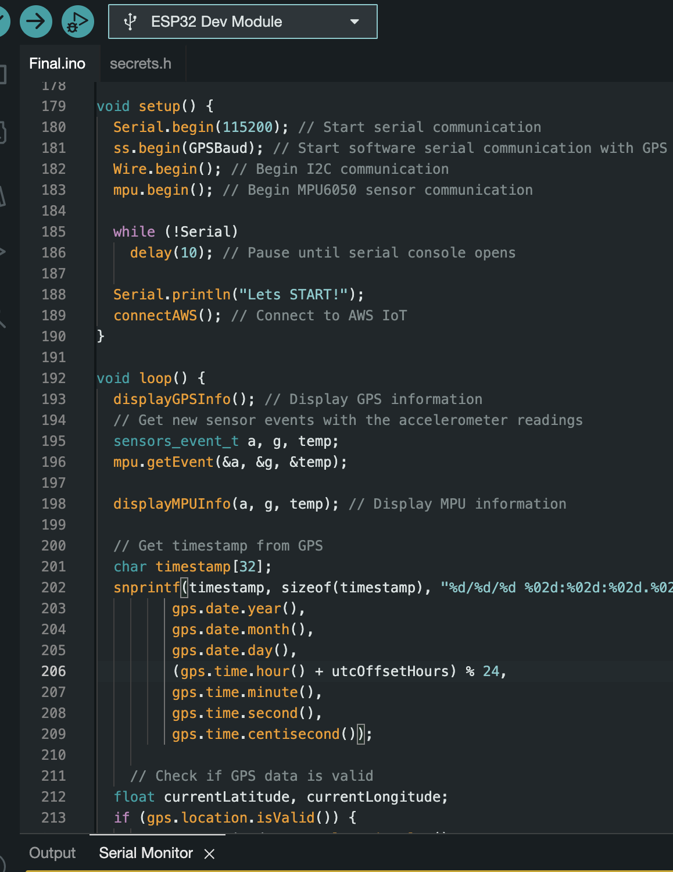
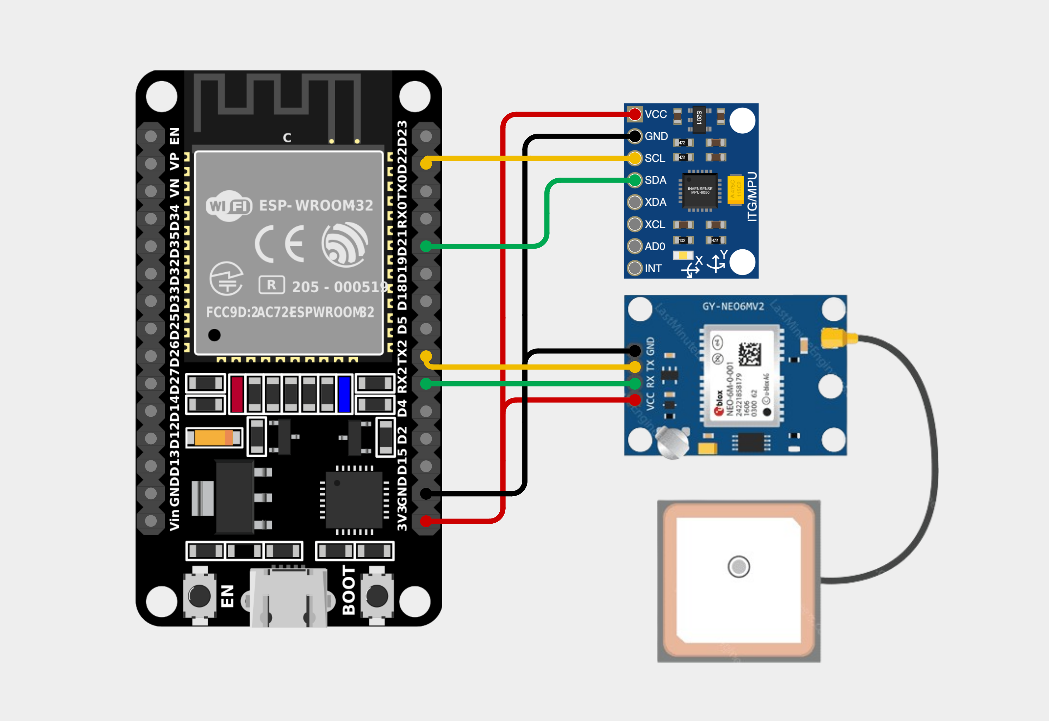
Hardware architecture

Slide 9

MQTT
MQTT facilitates efficient communication between devices and the cloud, ensuring seamless data exchange. To guarantee secure communication, TLS encryption protects data transmitted between the ESP32 and AWS IoT Core. Additionally, certificate-based authentication verifies the identity of devices using X.509 certificates. Together, these security measures bolster the integrity and confidentiality of data within the IoT ecosystem.

Slide 10





AWS services
IoT Core - securely connects IoT devices to the cloud, enabling communication, management, and integration with other AWS services.
AWS Lambda - is a serverless compute service that runs your code in response to events and automatically manages the underlying compute resources for you.
Amazon TimeStream - managed time-series database service, optimized for storing and analyzing time-stamped data at scale.
Amazon Grafana - visualization tool that transforms data into insightful graphs and charts, aiding in data analysis and visualization.
Amazon Simple Notification Service - managed messaging service by AWS that sends notifications to various endpoints like mobile devices and email.

Slide 11
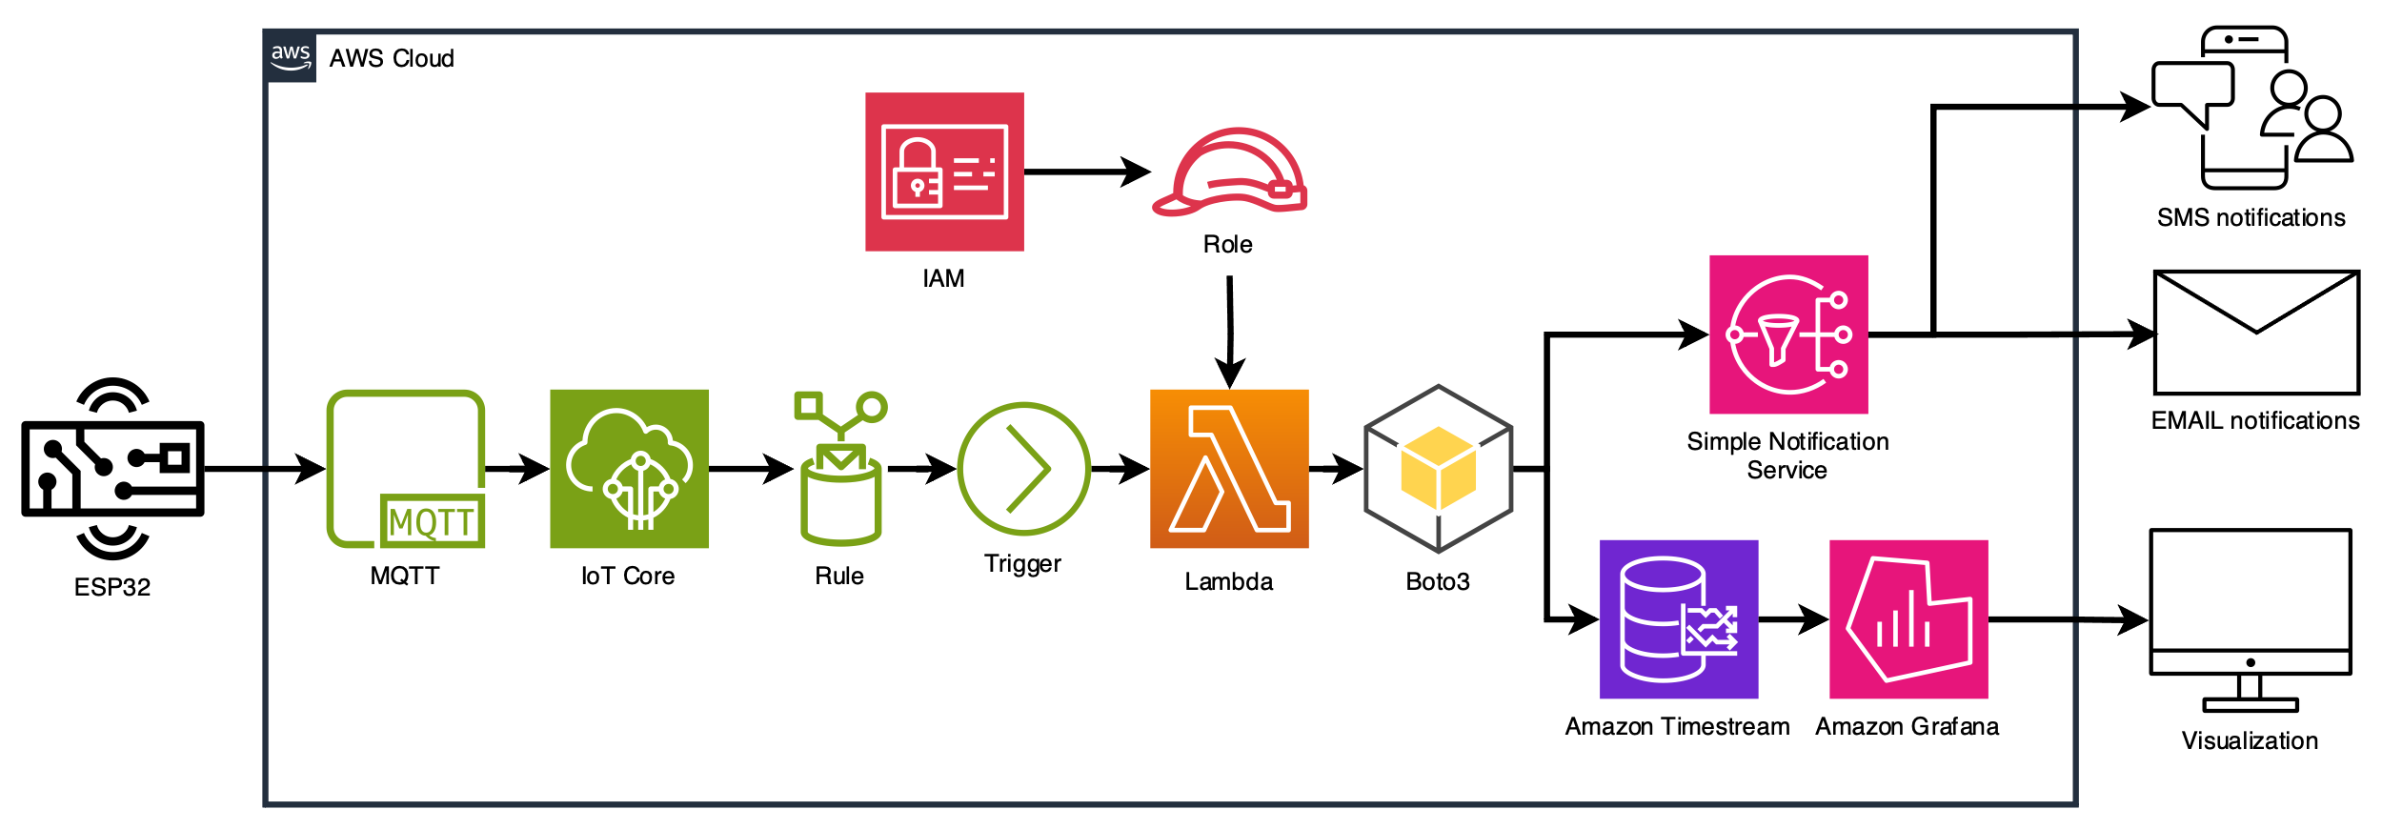
AWS architecture

Slide 12
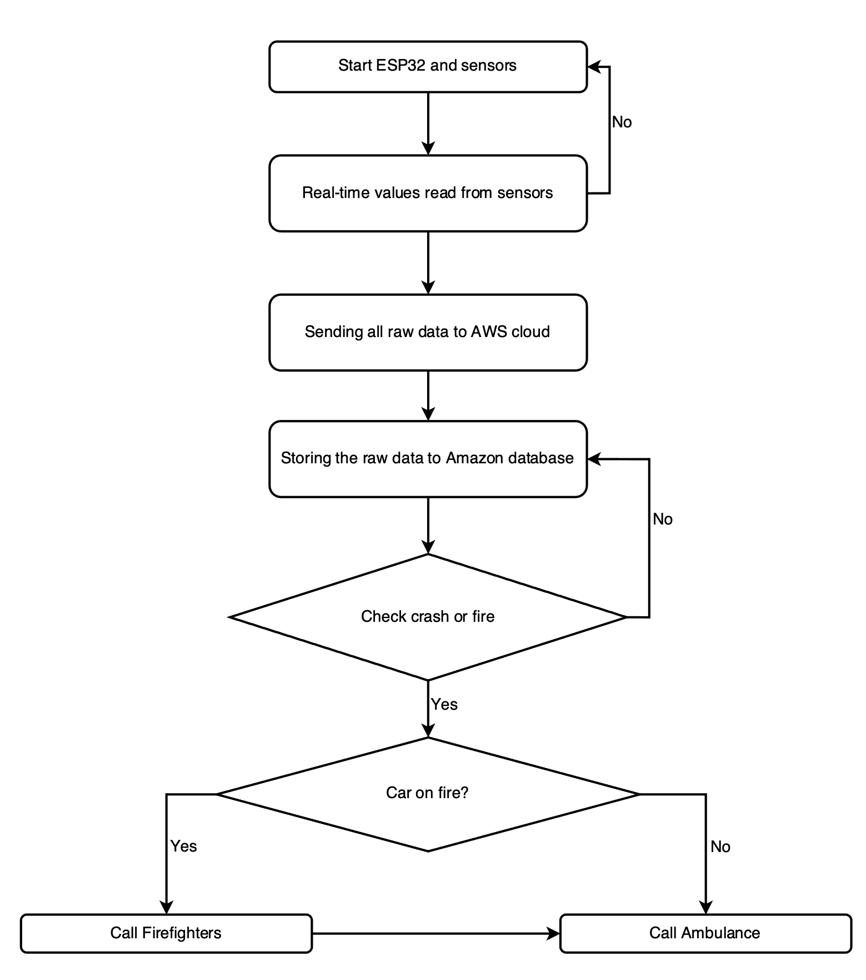
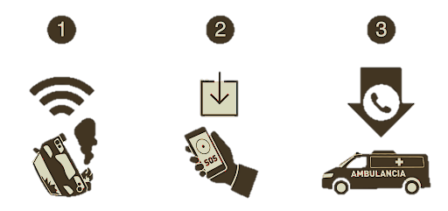
Flow chart

Slide 13

Security
Security Measures Implemented
ESP32:
Utilization of "secrets.h": Sensitive information like WiFi credentials and AWS IoT details are stored in a separate header file, enhancing security and preventing inadvertent exposure.
Security Protocols: MQTT over TLS ensures encrypted data transmission, while X.509 authentication mechanisms further bolster security.
AWS Services:
AWS IAM Integration: AWS services in the IoT ecosystem leverage AWS Identity and Access Management (IAM) for robust security measures.
Fine-Grained Access Control: IAM provides granular access control, authentication mechanisms, and least privilege access across services like AWS Lambda, Amazon Timestream, Grafana, and AWS SNS.
Enhanced Security Posture: By enforcing IAM policies, only authorized entities can access and interact with the services, ensuring a heightened overall security posture.
These combined measures fortify the IoT project's security infrastructure, safeguarding sensitive data and interactions at both the device and cloud levels.

Slide 14
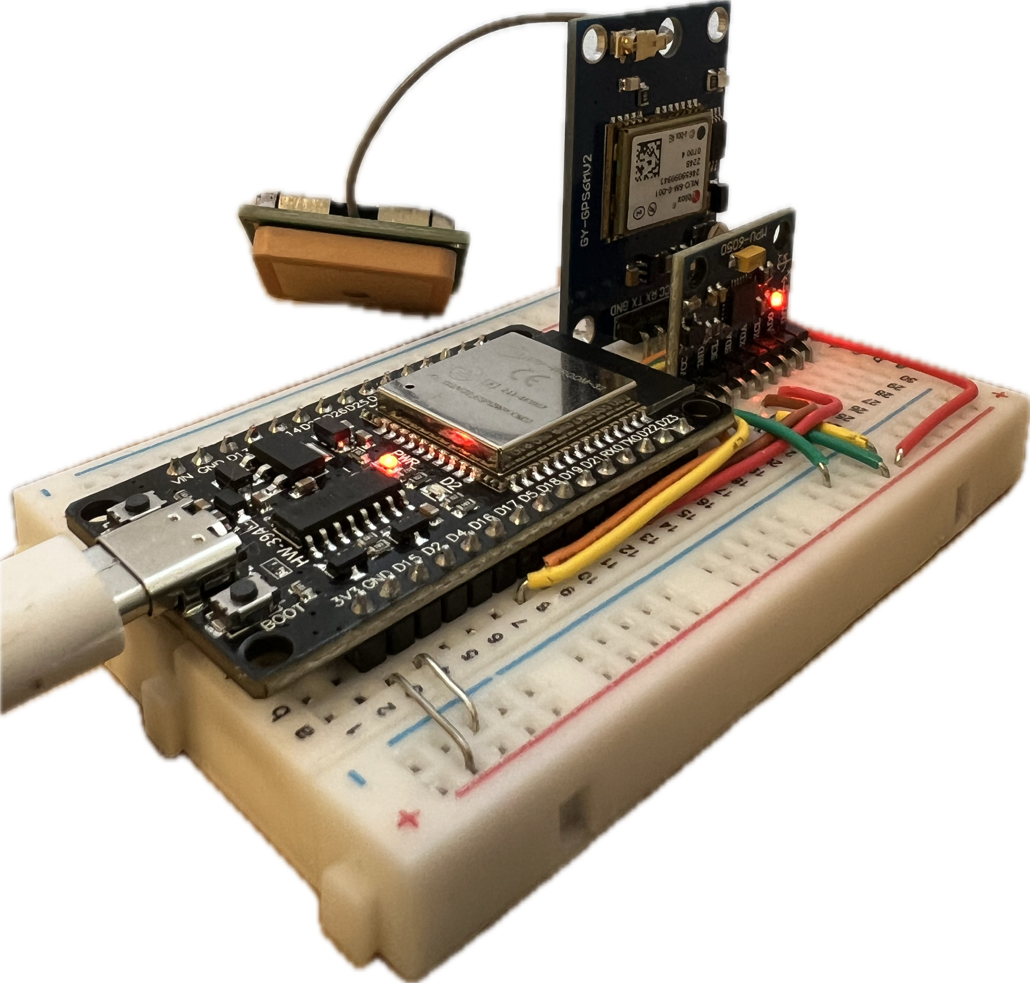
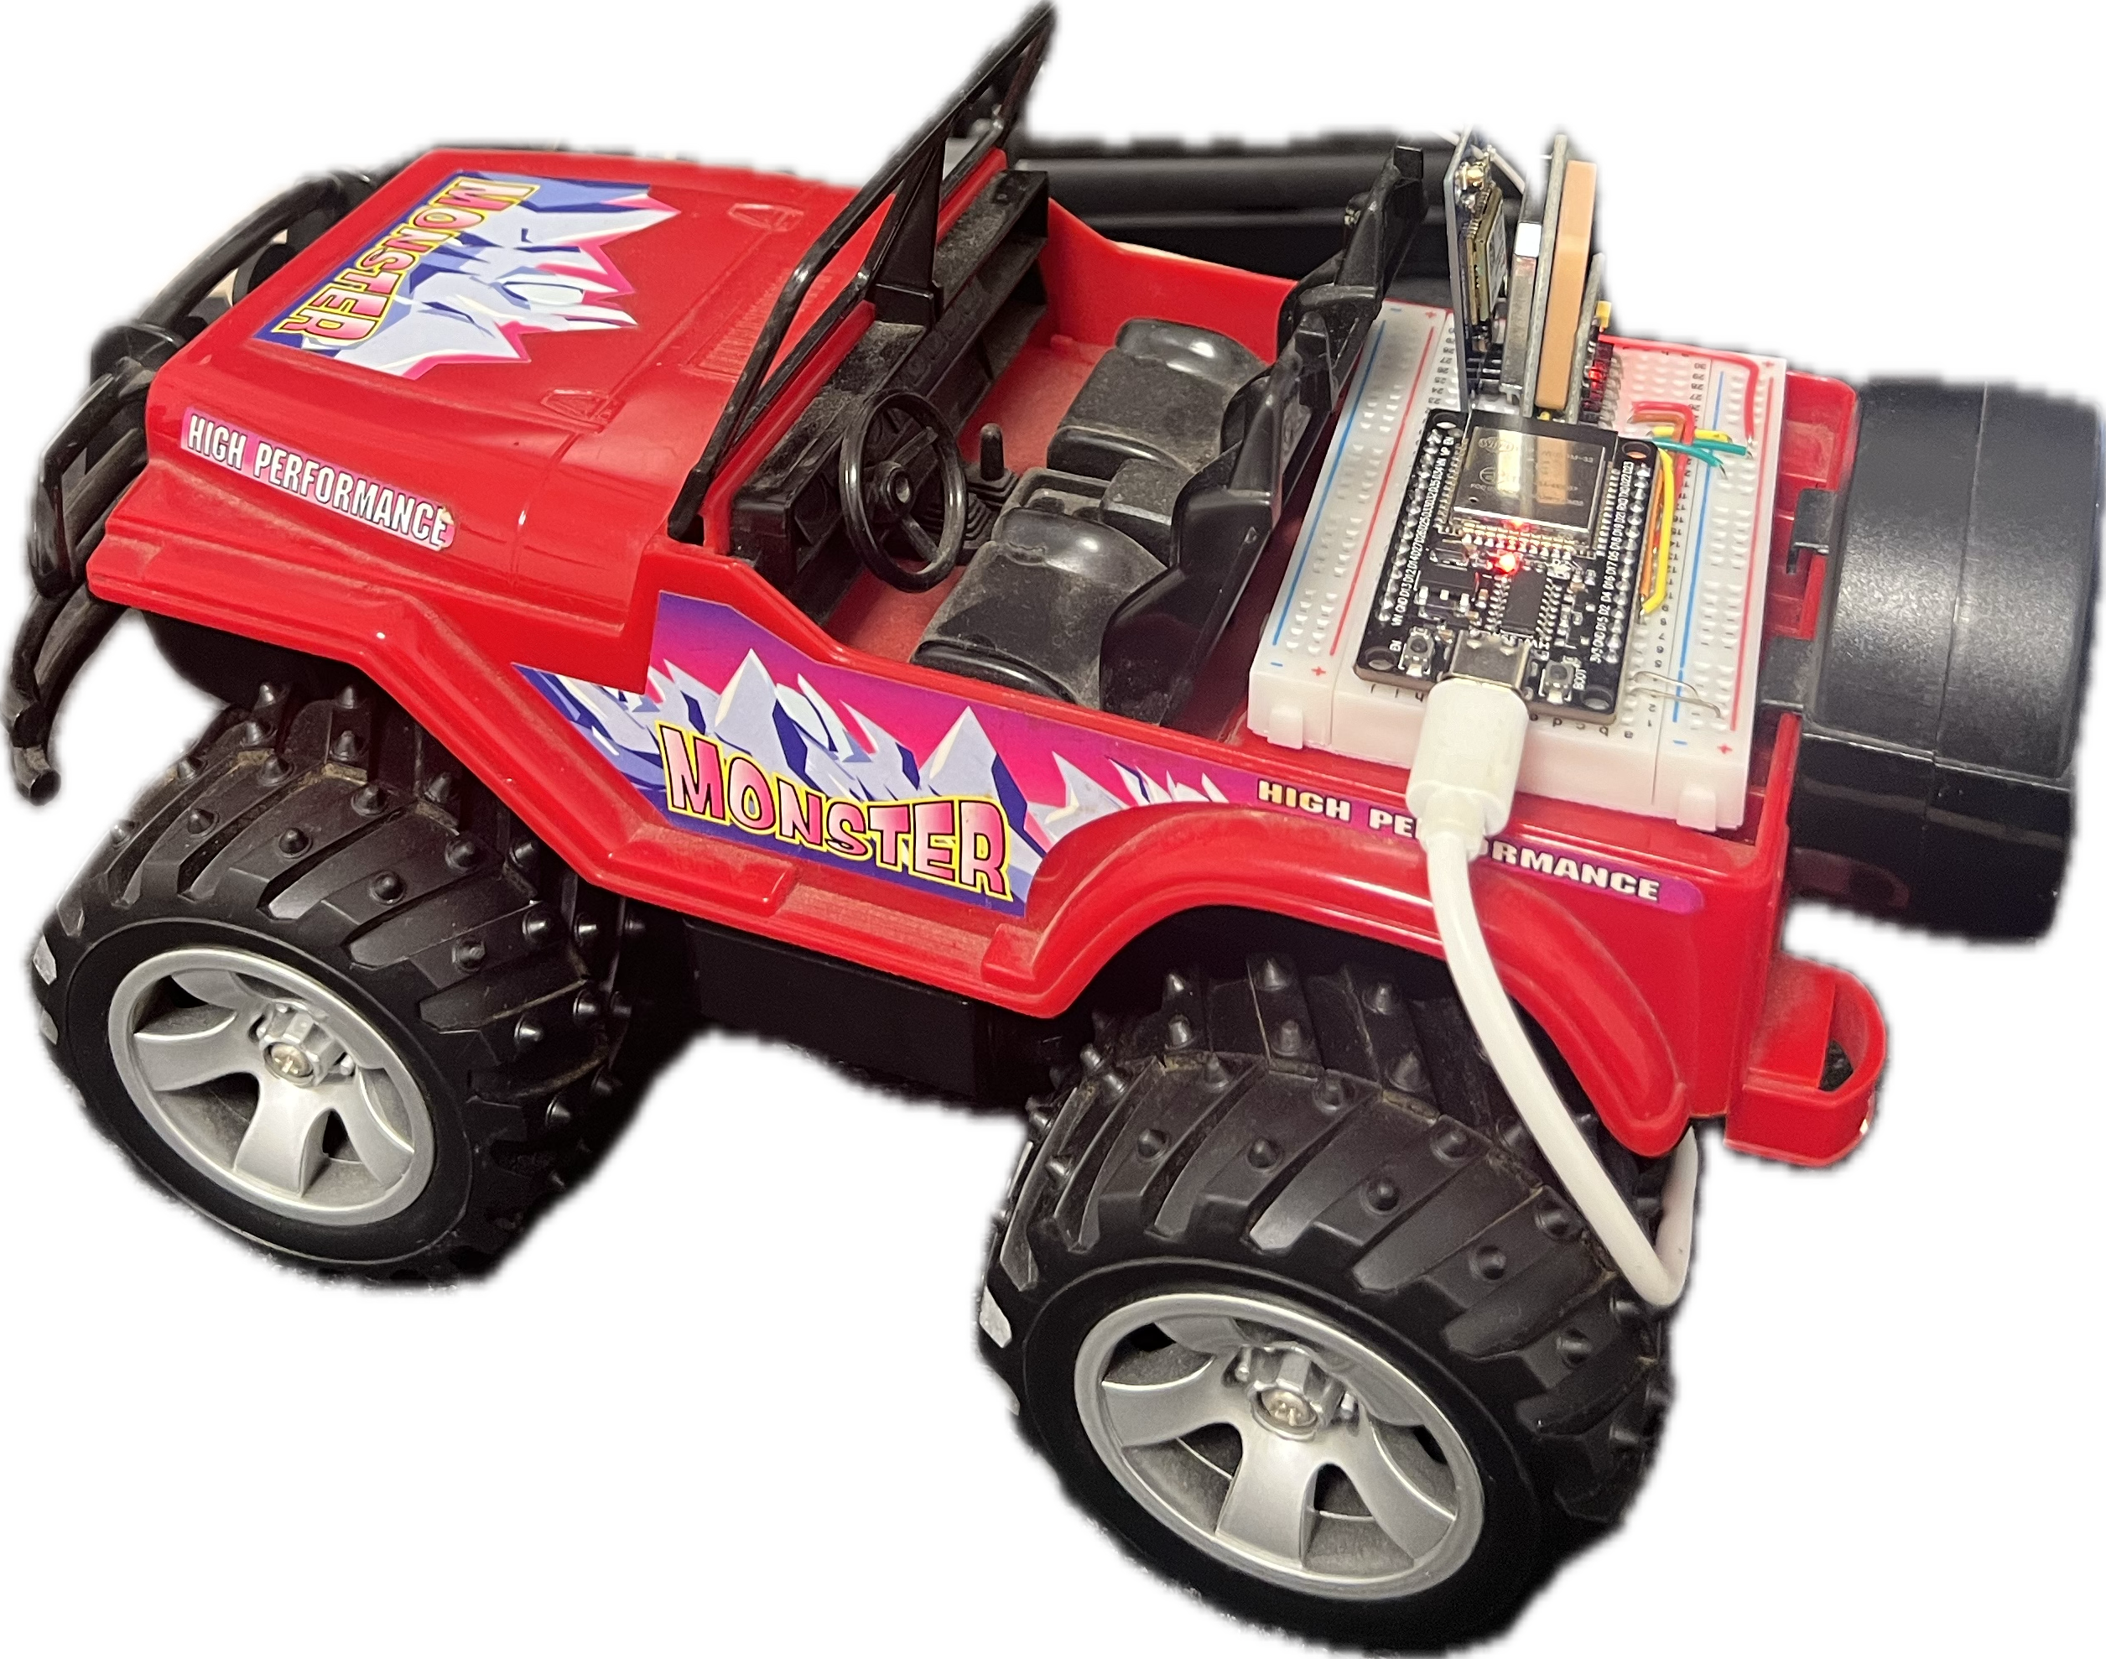
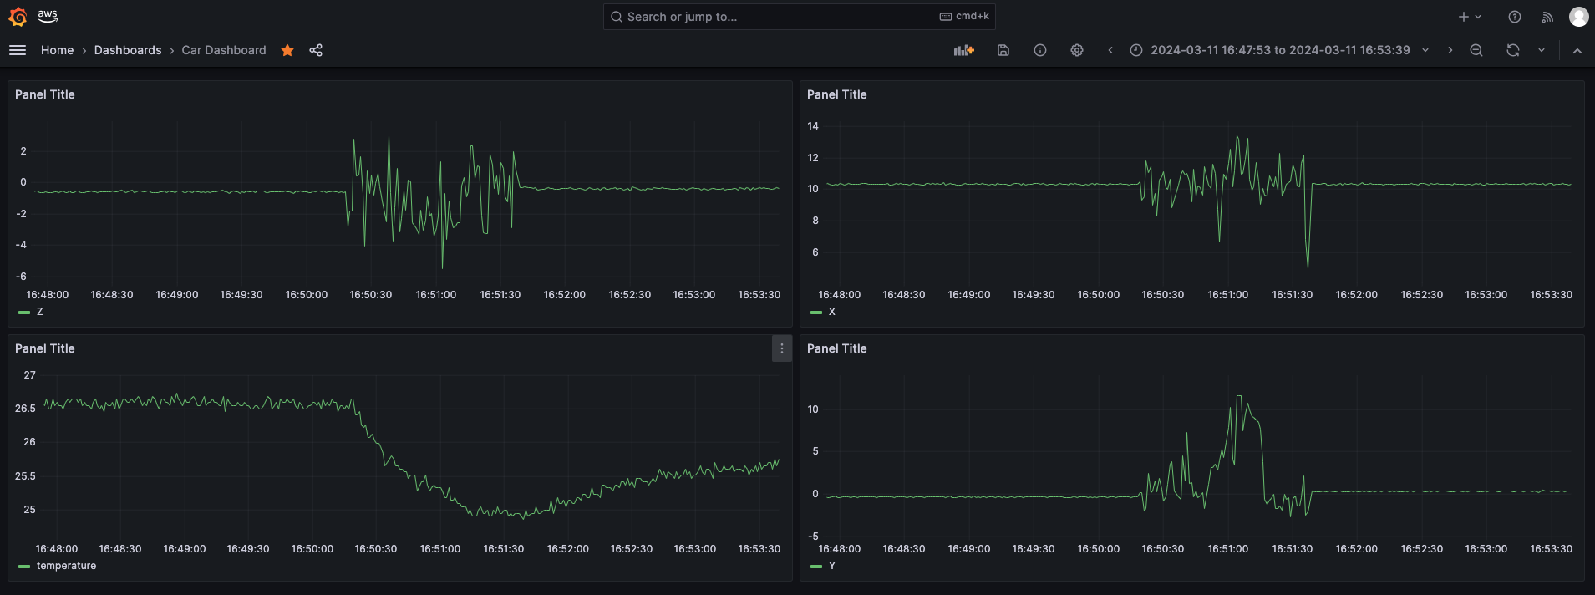
Results
AWS Grafana

Slide 15

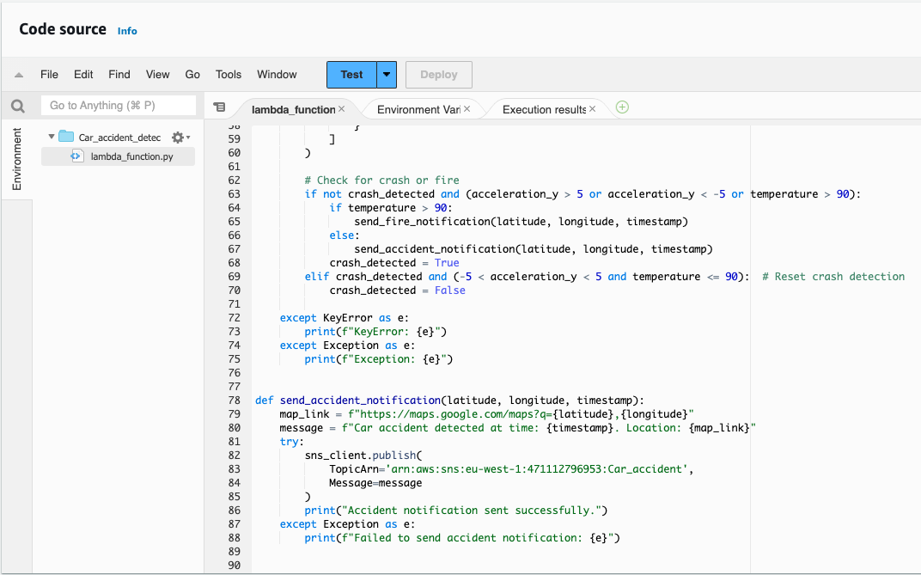
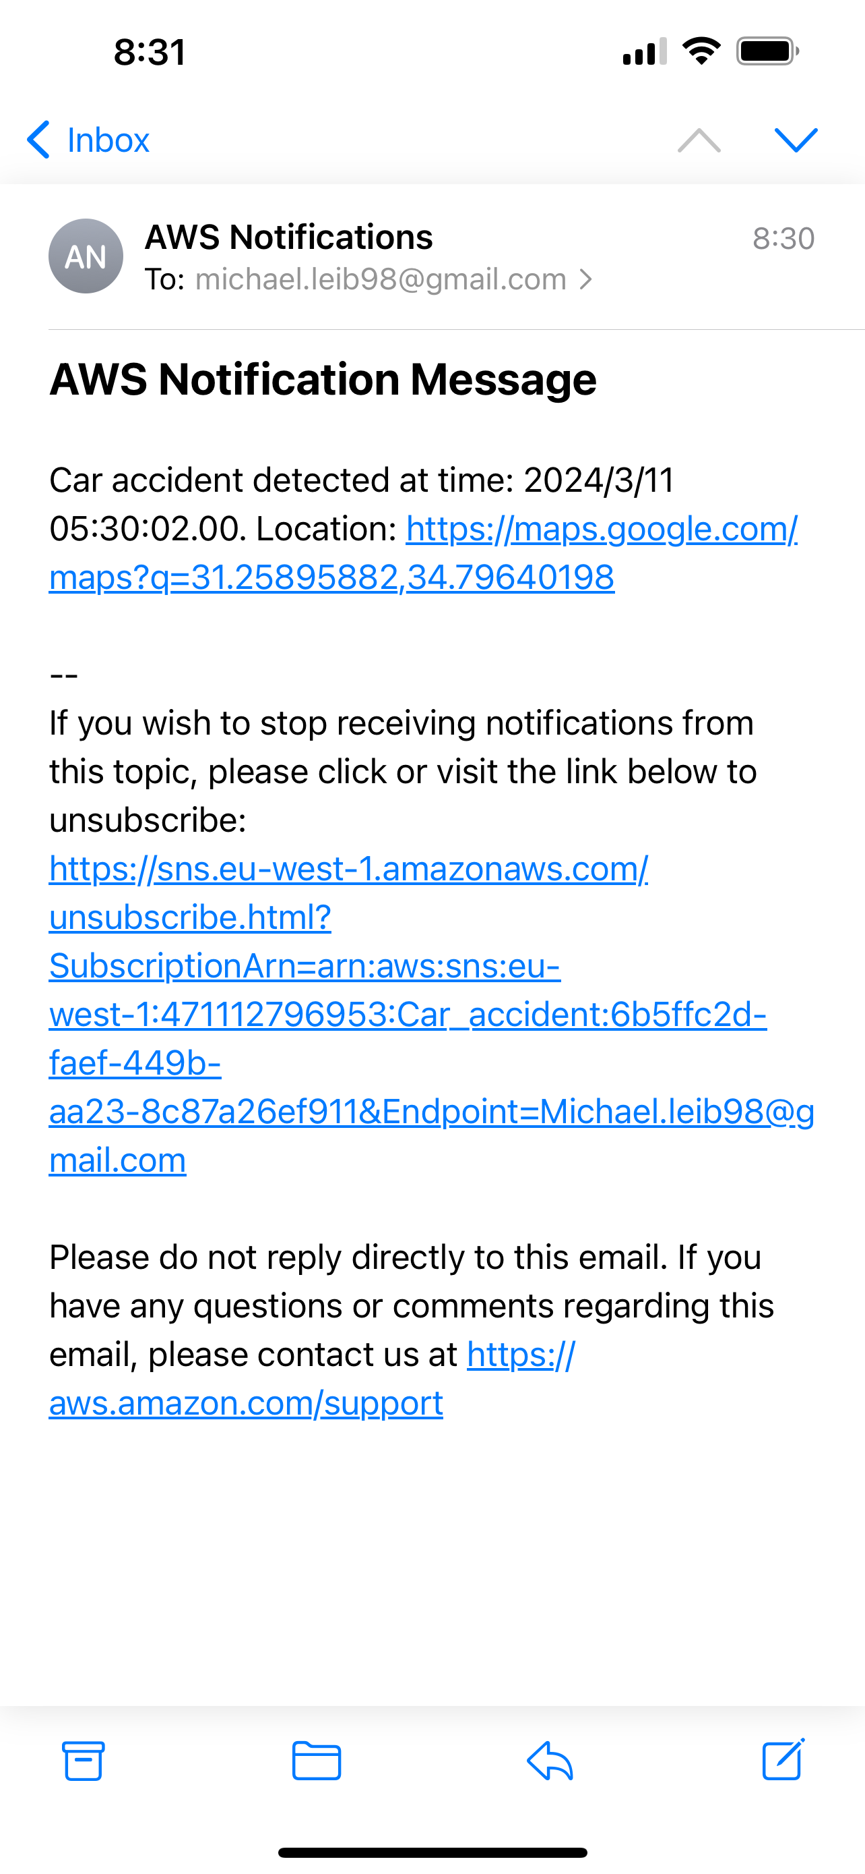

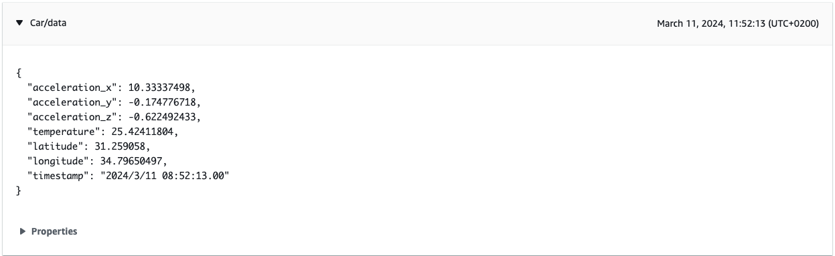
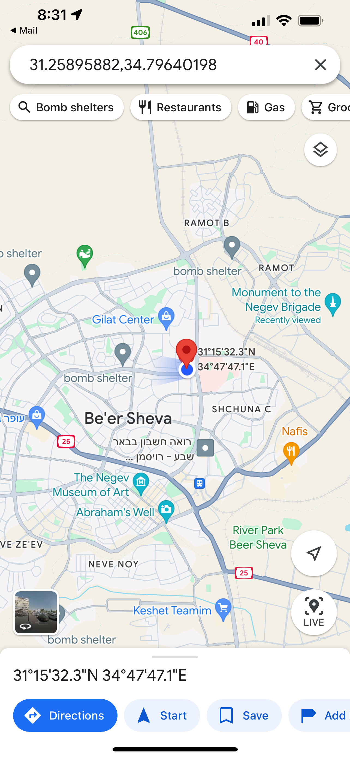
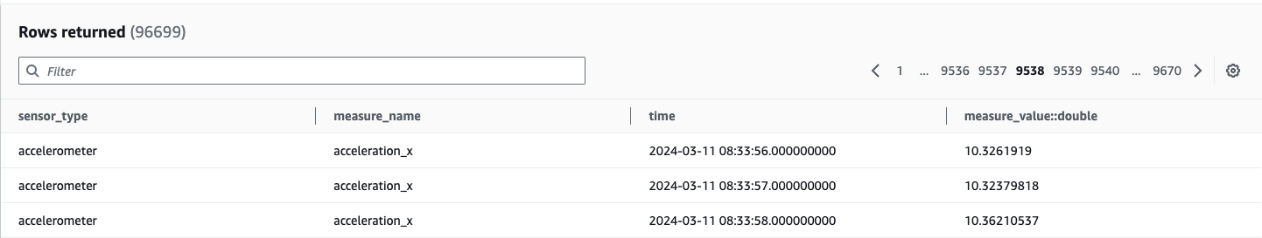
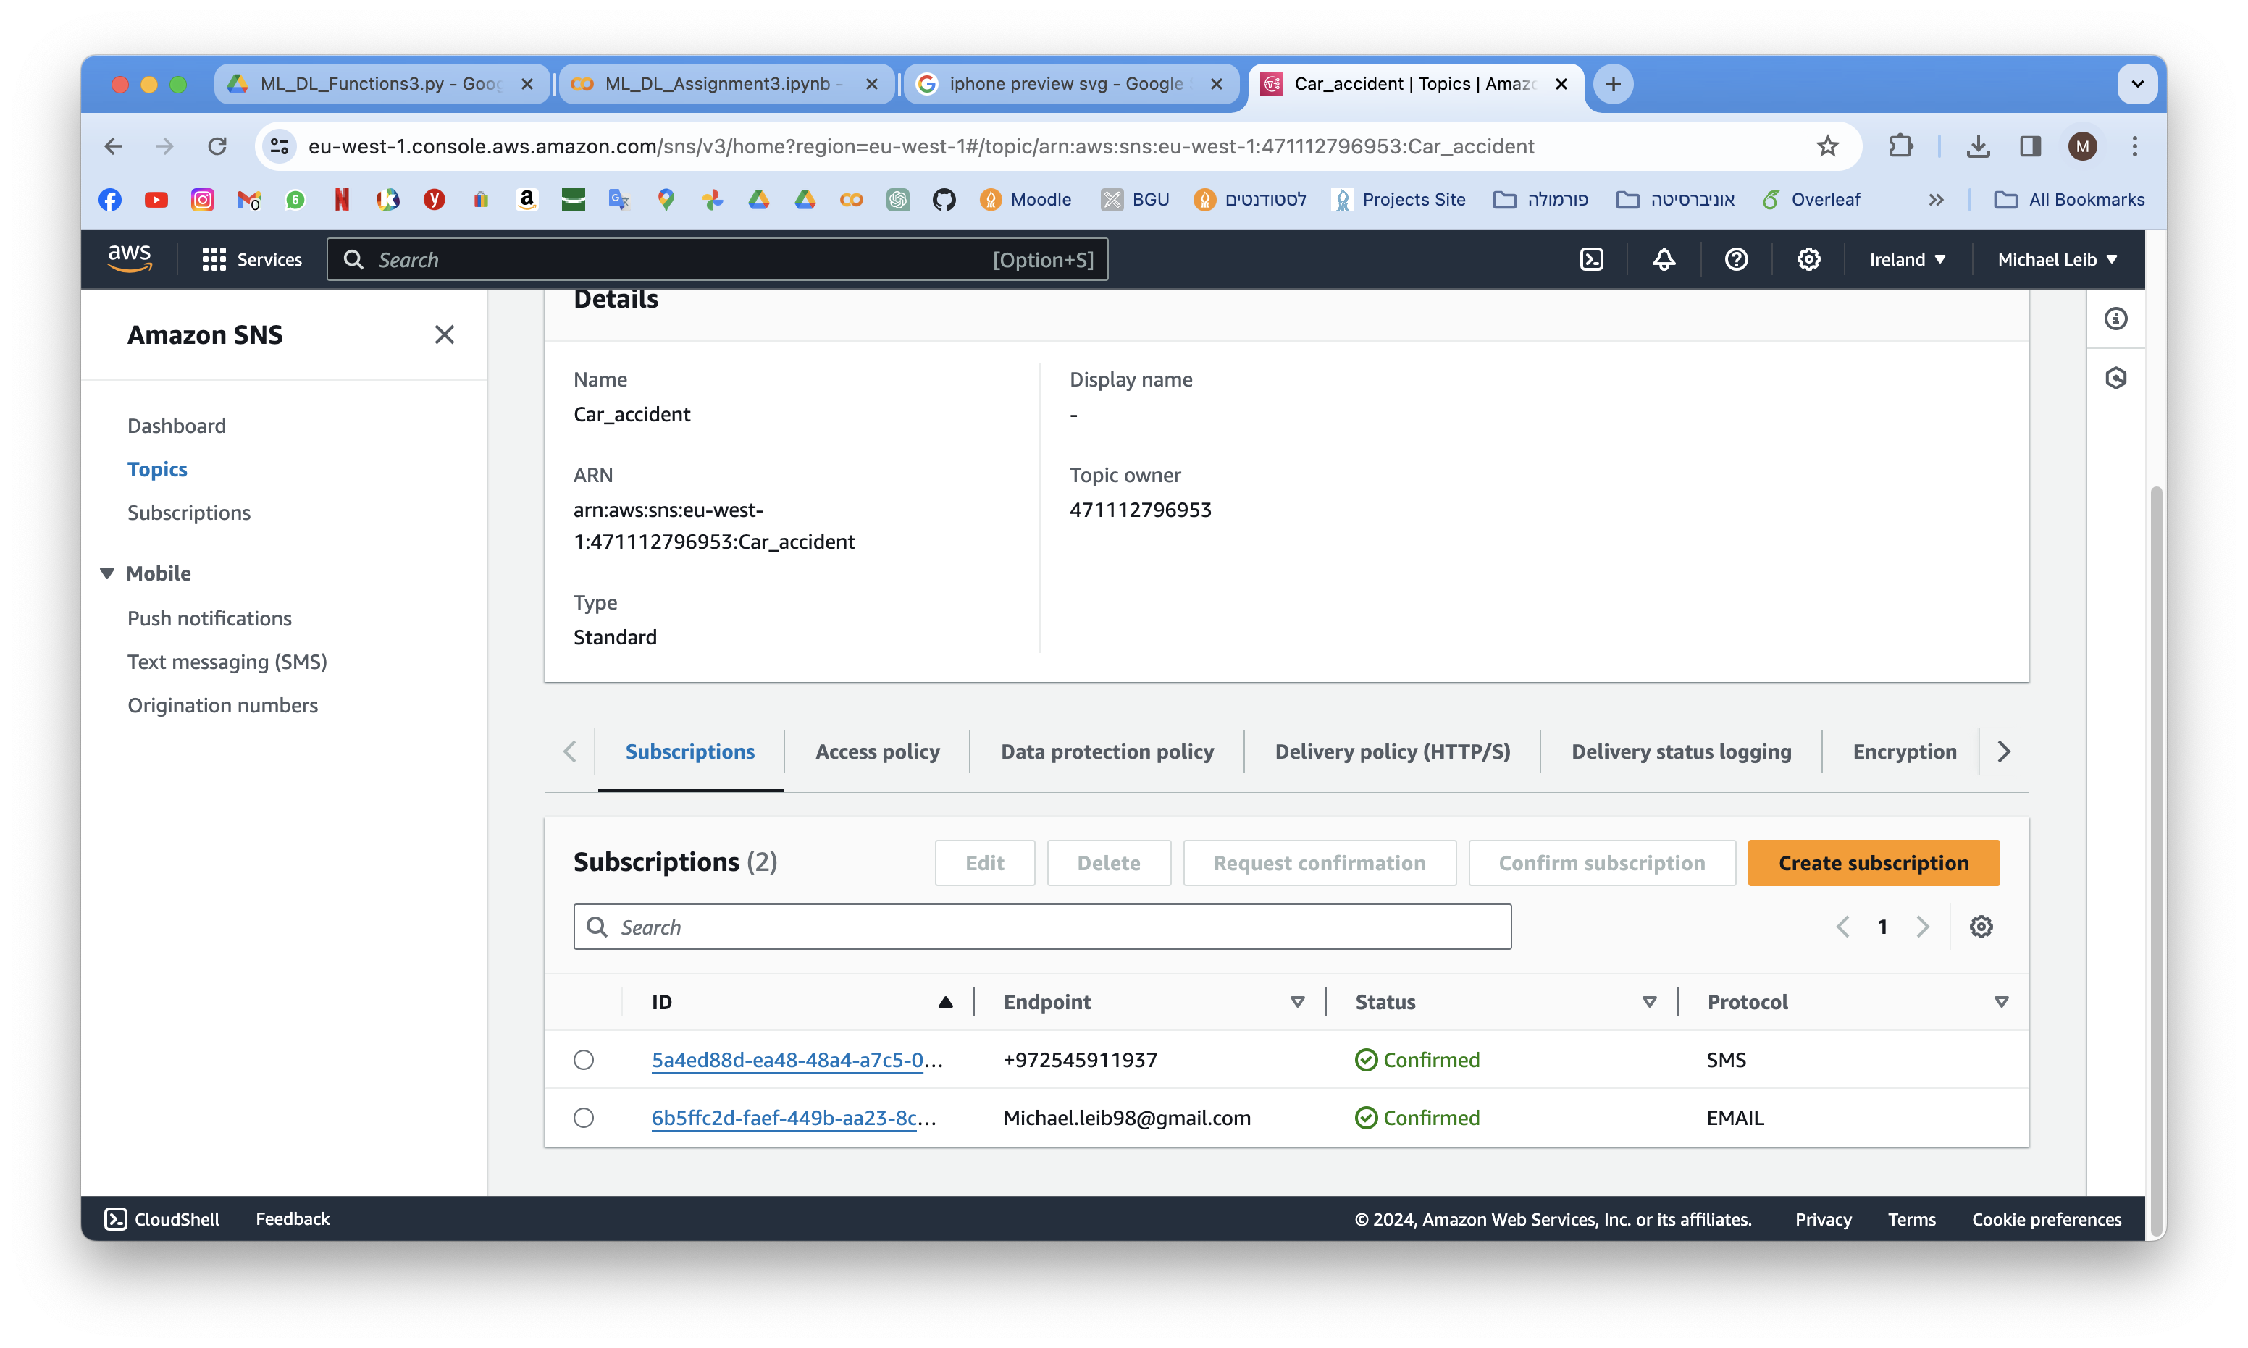



AWS Lambda
Fire alert
MQTT message
Timestream table
SNS subscriptions

Slide 16
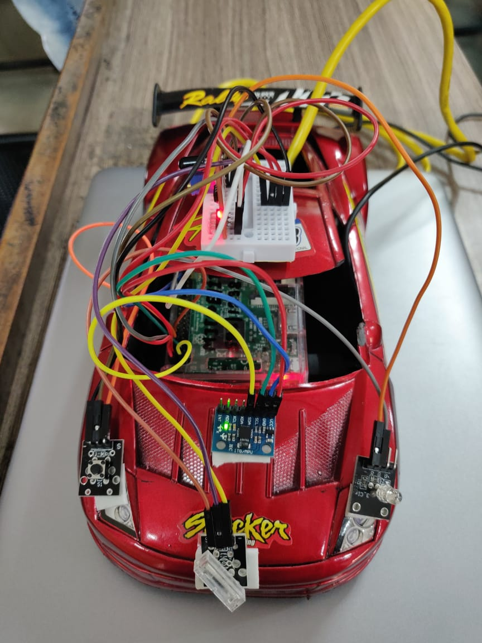
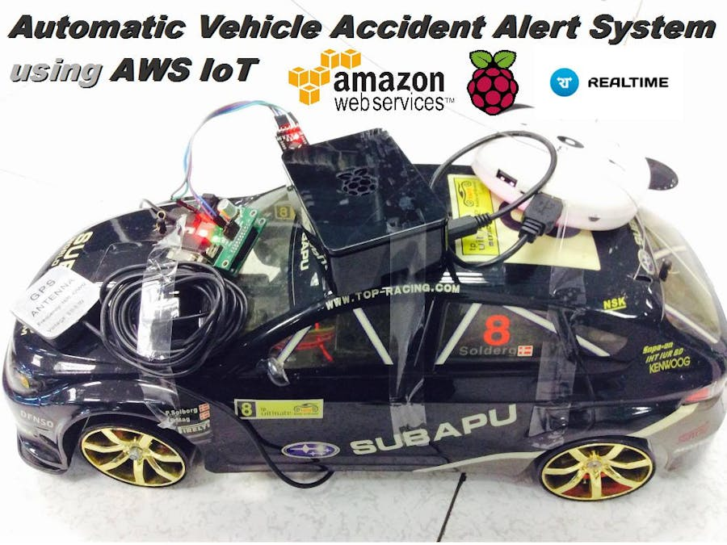
Related Article
“Iot based automatic accident detection and rescue management system” by supervision of Prof.(Dr.)Alok Kole, Professor , Department of Electrical Engineering
The paper discusses a concept for detecting accidents autonomously and monitoring a patient's vital signs in an ambulance. Accidents are detected automatically using a straightforward setup installed in the vehicle. Upon detecting an accident, the setup transmits the accident location to an ambulance, which promptly responds. Once the victim is in the ambulance, another setup continuously monitors vital signs like pulse, temperature, and blood pressure.

Slide 17
Insperation from the related Article
The entire process is similar except for some differences:
Their article continues to monitor the human's health after the accident.
Our product can detect a vehicle fire situation and inform emergency services accordingly article can solve the
They utilize a GSM module to directly send SMS messages from the hardware rather than relying on a cloud service.
Additional sensor types, such as airbag deployment sensors, can be implemented to enhance accident detection capabilities.
We can gather a wider range of data types for storage in the database, enabling the implementation of additional functionalities.

Slide 18
Thank you for listening

